Slide 1
Assignment-ǀ Explore the common package types
Group member:
SONG YANG
QU MINGXUAN XIAO SA

Slide 2
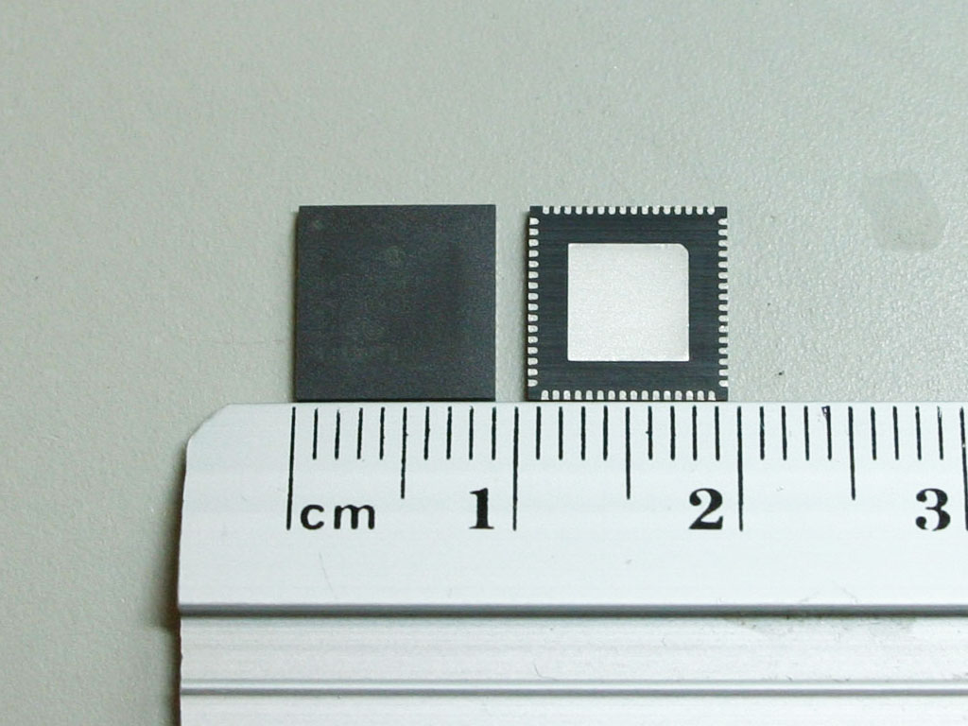
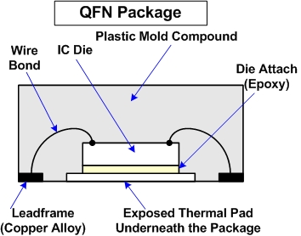
QFN – Quad Flat No-lead
Thermal:
Exposed thermal pad
Metal vias
Vibration:
Stress issue
Clamping condition(The better clamping condition was developed by Optimization of clamping hardware design, and clamping force.)
Size vs I/Os:
As thin as possible
No extension lead(hard to damage)
The number of I/Os approaches that of CSP/FBGA packages
Heat dissipation
Package size

Slide 3
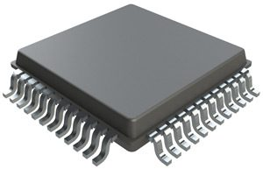
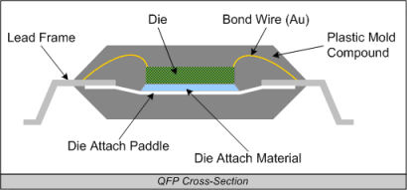
QFP – Quad Flat Pack
Thermal:
A buried metal
L shape of the external lead
Joint fracture or fatigue failure
Vibration:
alternating stress
random vibration load conditions
Size vs I/Os:
The ratio between chip area and package area is small.
Pins above 100
Package size

Slide 4
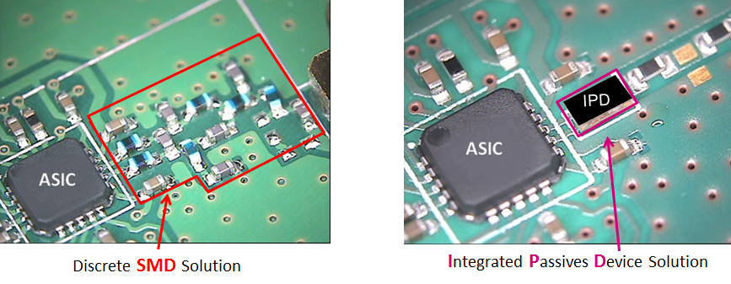
IPD – Integrated Passive Device
Thermal:
Standard wafer fabrication technologies
Passive components are separation
Reduce the heating effects
Vibration:
Soldered separately
Size vs I/Os:
Quantity of components
Reduce the I/O lead
Thermal implications
Vibration
Package I/Os

Slide 5
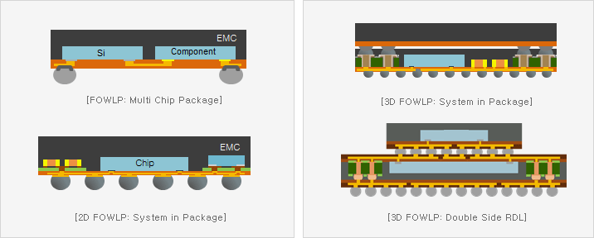
SIP – System in Package
Thermal:
Same with SoC
Less tightly integrated
Better reduce the thermal impact
Vibration & Size vs I/Os:
Stacked vertically on a substrate
Stacked chips together
Thermal implications
Package size and I/Os

Slide 6
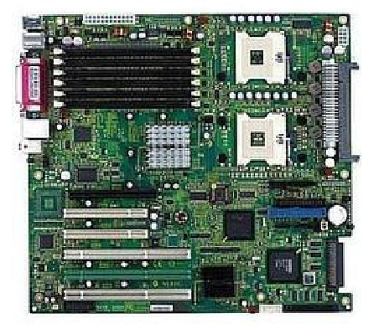
SOB – System on Board
Thermal implications
Because the size of the SOB is usually relatively large,the heat dissipation effect is better.
Effects of vibrations
Since the SOB has many separate discrete components which are affected by vibration. Therefore the vibrate reliability is reduced.
Package size vs I/Os
Due to the limitations of the chip, the size of the module and the power consumption, the PCB size and power consumption cannot be reduced without limit. Large package and traces cause large losses and parasitic parameters, which limits the system performance.

Slide 7
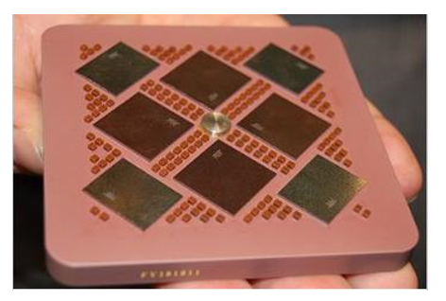
MCM – Multi Chip Module
A multi-chip module (MCM) is an electronic package consisting of multiple integrated circuits (ICs) assembled into a single device. An MCM works as a single component and is capable of handling an entire function
·Poor thermal conductivity of substrate
·Power dissipation heat
·No package to Single package has to be able to remove heat generated by all the ICs.
Low reliability due to high integration
• Smaller size and less weight
• Higher performance
• Lower cost

Slide 8
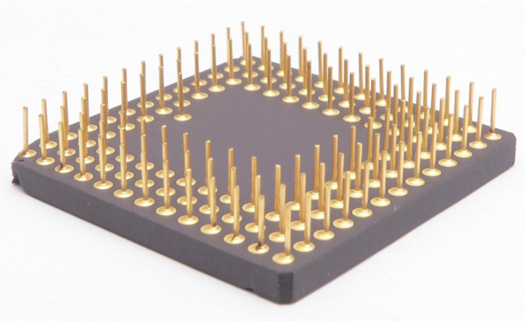
PGA-Pin grid array
A pin grid array, often abbreviated PGA, is a type of integrated circuit packaging.
PGA is usually connected to the heat sink. As the PGA gets bigger and dissipates more heat, the heat sink becomes larger and the heat sink is often combined or connected to the PGA.
The motherboard only needs to provide a jack for inserting pins. And because it requires multiple movements, the PGA's stitches are relatively stronger, and even if they are bent, they can be recovered in a relatively simple way.

Slide 9
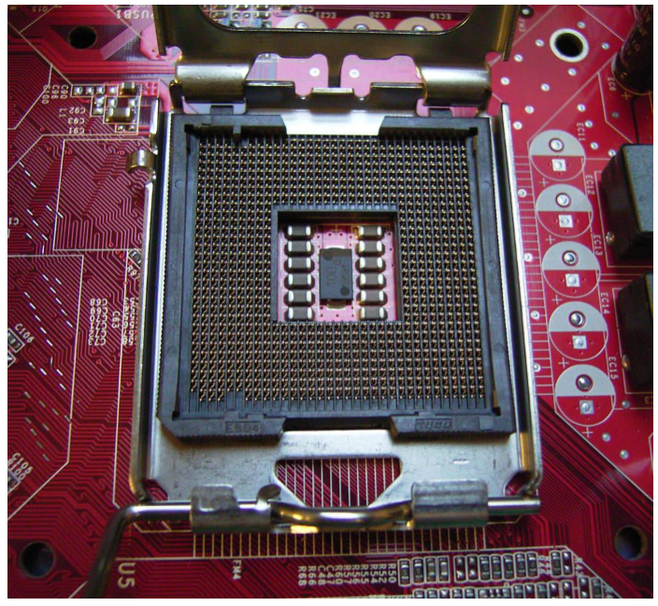
LGA-Land grid array
The land grid array (LGA) is a type of surface-mount packaging for integrated circuits (ICs) that is notable for having the pins on the socket (when a socket is used) rather than the integrated circuit.
There may not be enough space between an LGA package and the circuit board to accommodate a chip clip-on heat sink due to the lower stand-off height of LGA.
Because the socket pins contact the pads, socket pin wear and load reduction during vibration are some of the key structural risks.
LGA can accommodate more I/O pins in a smaller package.

Slide 10
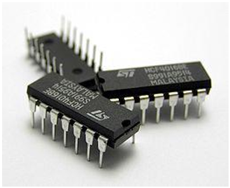
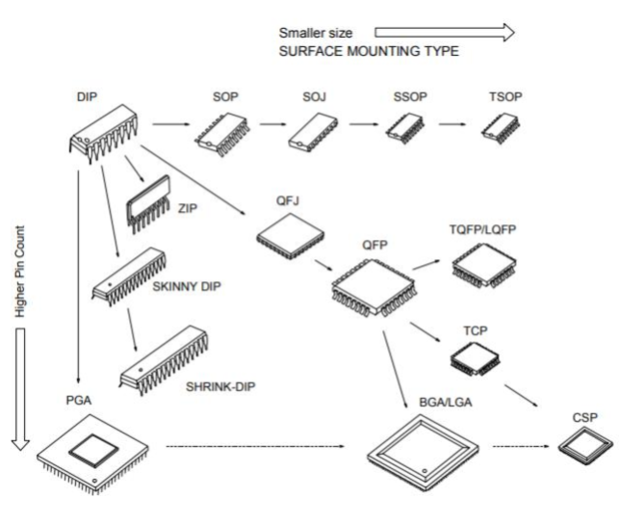
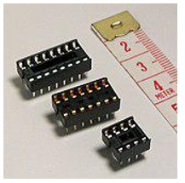
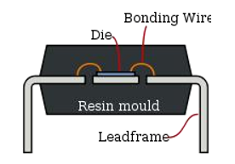
DIP–Dual In line Package
DIP cooling conditions :
1) natural convection cooling
2) artificially circulated air
3) cooling under a liquid or on a water cooled copper block.
14-pin plastic DIP packages
wide DIP sockets for 16-, 14-, and 8-pin DIP ICs
Side view of DIP

Slide 11
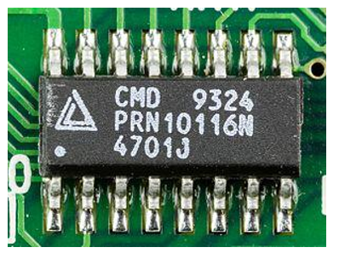
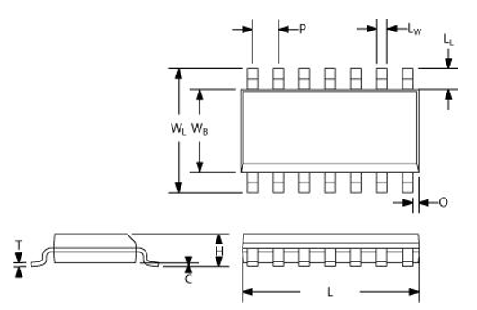
SOIC–Small Outline Integrated Circuit
SOIC-16
general shape of a SOIC narrow package

Slide 12
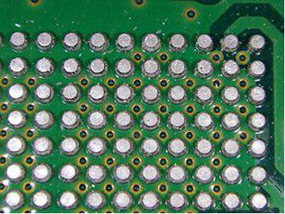
BGA–Ball Grid Array
The array of spherical contacts facilitates heat dissipation. The contact surface with the substrate is large and short, which is conducive to heat dissipation
The BGA pin is rugged and does not have pin deformation problems like QFP.
It occupies a large area of the substrate.

Slide 13
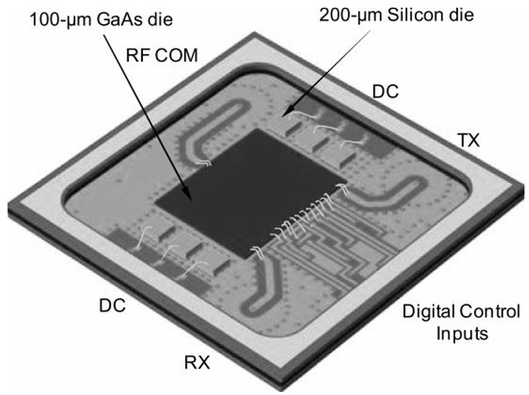
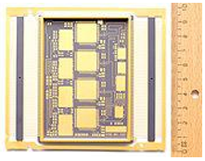
LTCC-Low Temperature Co-fired Ceramic

Slide 14
Conclusion
Package Type | Thermal Implication | Effects of vibration | Package size vs I/Os
QFN | ＊＊＊＊＊ | ＊＊＊ | ＊＊＊
QFP | ＊＊＊＊＊ | ＊＊＊ | ＊＊
IPD | ＊＊＊ | ＊＊＊ | ＊＊＊
SIP | ＊＊＊ | ＊＊＊ | ＊＊＊
SIB | ＊＊＊＊ | ＊＊＊ | ＊
MCM | ＊＊＊＊＊ | ＊＊＊ | ＊＊＊＊＊
PGA | ＊＊＊＊＊ | ＊＊＊ | ＊＊＊＊＊
LGA | ＊＊＊＊＊ | ＊＊＊ | ＊＊＊＊＊
DIP | ＊＊＊ | ＊＊＊＊ | ＊
SOIC | ＊＊＊ | ＊＊＊＊ | ＊
BGA | ＊＊＊＊＊ | ＊ | ＊＊＊＊＊
LTCC | ＊＊＊＊＊ | ＊＊＊＊＊ | ＊＊＊＊＊

Slide 15
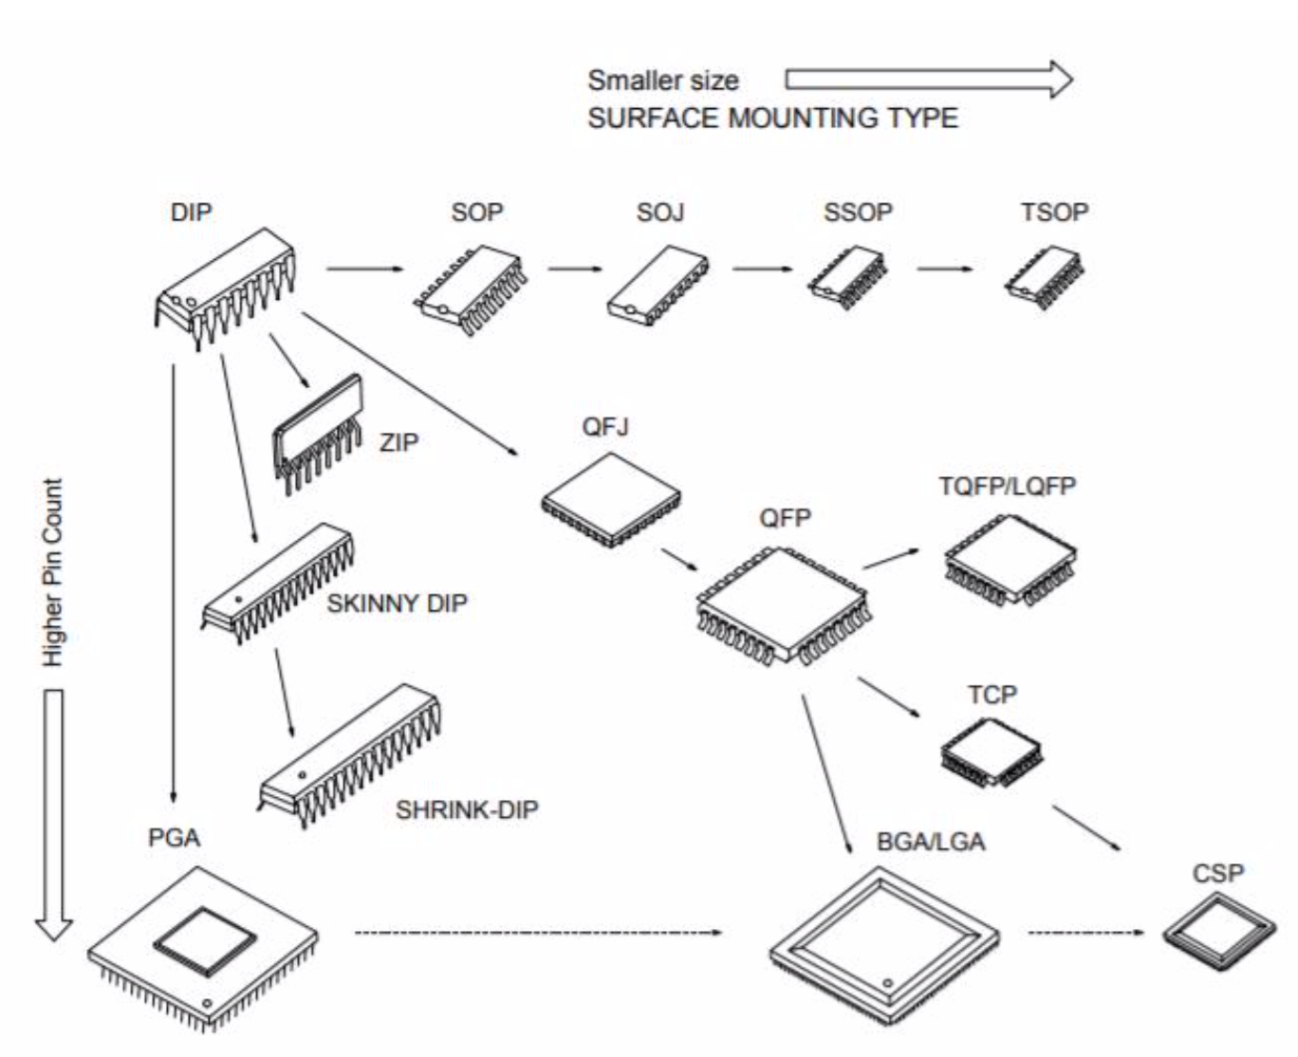
Package Classification | Members
microprocessor | LGA BGA PGA
Phone, Bluetooth, GPS... | QFN SIP IPD QFP
EDU | DIP
3D | SIP MCM SOIC

